Slide 1
Homoverseas
Business Plan
of a homestay application
Stephanie 姚苏倪 Suky 赵舒涵
Muriel 曹君宸 Eddie 何润卿

Slide 2
Contents
1 Introduction of our product. . . . . . . . . . . . . . . . . . . . . . . . . . .1
1.1 The reason why we developed the product. . . . . . . . . . . . . . . .1 1.2 Key features of our product. . . . . . . . . . . . . . . . . . . . . . . .1 2 Our business objective. . . . . . . . . . . . . . . . . . . . . . . . . . . . .2 2.1 Former stage. . . . . . . . . . . . . . . . . . . . . . . . . . . . . . . .2 2.2 Later stage. . . . . . . . . . . . . . . . . . . . . . . . . . . . . . . . .2
3 Type of organizations of our business. . . . . . . . . . . . . . . . . . . . .4 4 Organization chart. . . . . . . . . . . . . . . . . . . . . . . . . . . . . . .5
5 Market segment and target market. . . . . . . . . . . . . . . . . . . . . . .8 6 Questionnaire. . . . . . . . . . . . . . . . . . . . . . . . . . . . . . . . . .10 6.1 Introduction. . . . . . . . . . . . . . . . . . . . . . . . . . . . . . . . .10 6.2 Content of Questionnaire. . . . . . . . . . . . . . . . . . . . . . . . . .10
6.3 Questionnaire releasing plan. . . . . . . . . . . . . . . . . . . . . . . .13 7 Marketing mix. . . . . . . . . . . . . . . . . . . . . . . . . . . . . . . . . .14 7.1 Product. . . . . . . . . . . . . . . . . . . . . . . . . . . . . . . . . . .14
7.1.1 Our product image. . . . . . . . . . . . . . . . . . . . . . . . .14
7.1.2 3 easy steps to book a host family. . . . . . . . . . . . . . . . .14 7.1.3 More functions. . . . . . . . . . . . . . . . . . . . . . . . . . .16
7.2 Price. . . . . . . . . . . . . . . . . . . . . . . . . . . . . . . . . . . . .17
7.3 Place. . . . . . . . . . . . . . . . . . . . . . . . . . . . . . . . . . . . .19
7.4 Promotion. . . . . . . . . . . . . . . . . . . . . . . . . . . . . . . . . .19
8 Predicted profit and loss statement of the first two years. . . . . . . . . . .20

Slide 3
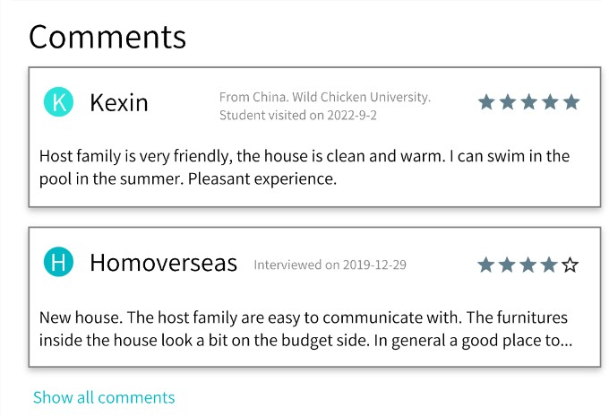
Introduction of our product
The reason why we developed the product
For international students, most of them need to find host families or apartments to live in when they are going to study abroad. We noticed that most students have their host families chosen not by themselves, but by their schools or other institutions, which lead to the consequence that they cannot connect with their host families directly and lack of some key host family information that they may not be satisfied with. What’s more, for host families, they also worried that the students living in their home may not obey their instructions and rules.
In order to create better relationship between the host families the and international students, we develop our product, Homoverseas, to solve this problem. We provide students with the right to choose the suitable and comfortable homestay they like and ensure them with the quality and validity of information by providing comments, ranks, profiles of the host family.
1.2 Key features of our product
The most special part of our product compared to other similar product which are our competitors, likeStayInFamilyandBooking.com, is that our product not only show the comment from students for host family, but also provide the host family with the ranking system so that they can see the stars rank of the students given by their past host families.
Figure 1: When students enter a page of a specific homestay introduction, they can see the comments of the home from both former students and the staff of our cooperation.

Slide 4
Our business objective
Homoverseas’ objectives can be basically divided into two stages: the former stage and the later stage. These objectives are all what our company need to focus on. They can provide direction for our company’s future growth and also motivate the enthusiasm of our staff to pay attention on our works.
Former stage
Survival
In early days, Homoverseas may suffer from a harsh time for the lack of profit and lack of customers. As an international website, it’s both time consuming and cost lots of human resource and finance to operate this whole industry: from the establishment of the website to the finding of available house resources in different countries and finally to the homestay agency service provided. Though several investment strategies (which provided in the “Price” section) can guarantee enough finance to support us to struggle though this period, we might still face several problems like competitive Internet environment and not enough customer base which means the invalidity of our promotion strategy penetration. These cause issues which will affect the survival of our company.
Increase sales revenue
Sales revenue is another challenge Homoverseas need to face. By using the pen- etration of pricing strategy during the first stage, there’s no uniqueness present and cannot attract customers so effectively and eye-catching. With lower or same price as our competitors, our objective is to ensure our economical image and at the meanwhile increase as much sales revenue as we can to compensate the loans and to earn finance for future development of our company.
2.2 Later stage
1. Provide quality services Customer satisfaction
During the second stage, as our customer base is established and earned enough profit in the first stage to support our further App’s functioning, our pricing strategy transforms from penetration to cost plus and skimming. At this stage, several unique- ness in our app’s function like one-to-one communicating channel, offline house viewing service and ranking system is presented. Our objective is to ensure our image with high quality from our customers and earn satisfaction from them. So that, more loyal customers can form and recommend Homoverseas to families or friends overseas.

Slide 5
Profit maximization
Since several specialties are shown in our App during this second stage, the price of both our service and our advertising space should also increase to attain our objectives of profit maximization. This objective can help our App to maintain the finance income and provide more advanced service for customers to ensure our future development and motivate our staff to work harder to earn more salaries.
Growth
Growth always serves as an important objective in our objective. By expanding housing resources and service to more country, we can increase our market share at the same time and be more competitive with more suitable homestay for customers to choose.
Corporate social responsibility
This is one of our objectives because we are Homoverseas who provide home to our customers, overseas students. The establishment of our APP at first come up with this idea to help more overseas students and we want our App to have social impact so that more students can have find a comfortable homestay even outside of our country. Thus by participating in more activities to show our social responsibility, we can increase our APP’s image and reputation as well as make more customers to find us to seek service from us.

Slide 6
3 Type of organizations of our business
Our company will start as a private limited company. Firstly, we can control most of the shares in our hands so that our company won’t be easily bought by other big companies by acquisition. Each of us will hold 20% of the shares and the left will be given to our employees. (Also in our contract we will add a rule that if any of us want to sell more than 4% of the shares, she or he needs to be agreed by other three people.) Because shares can only be sold privately, often to family members, friends or employees, so the money to run our business may be hard to raise. This may cause the initial scale of our company not complete which means we will only have necessary post. After we make enough profit from our business, we will start to enlarge our scale and recruit more employees to help the company become more competitive and make What’s more, because ownership is not separated from control in private limited company so people who own shares will spare no effort to work for the company. Also, being a private limited company can decrease the cost of flotation.
What’s more, we won’t let our company go public for the following reasons.First, once our company is listed, we will be required providing our financial data which we do not want our competitors to see.The reason why we do not want our competitors to see our financial data is that, if they know a lot about our financial condition, they may use price strategy to compete with us of the cooperation with foreign agency. If they do not know our financial condition, we can gain more chances to cooperate with foreign agency for the reason that we started our business earlier than other companies and have a better reputation.

Slide 7
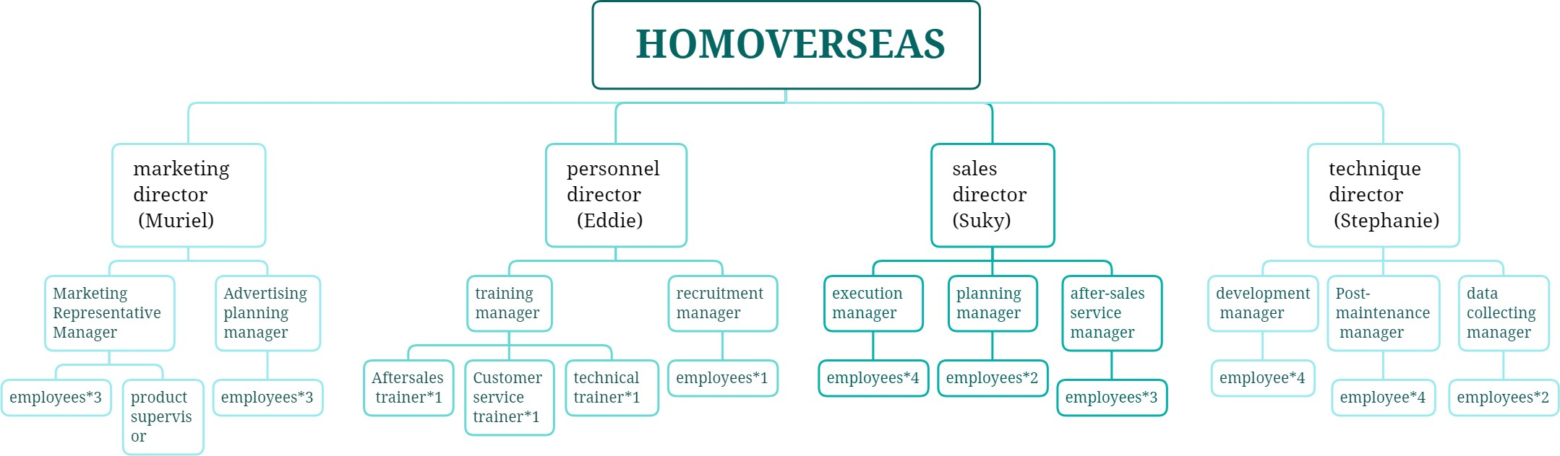
4 Organization chart
Because our company is at a enlightenment stage so there won’t be too many stuff in our company.In order to make our company better connected together and also more easier to controlled, the hierarchy is flat and the span of control is also relatively narrow. So as you can see,because the we four students are the founders of the company so that we are also the directors of department.
Stephanie is good at designing programme so she is the director of technique depart- ment.
Suky is good at making sale strategy and also skillful at communicating so she is the director of sales department.
Muriel is good at art, designing and also has a long term view and deep analysis of the market.So she is the director of marketing department.
Eddie is good at judge people’s characteristics and qualities so he is the director of personnel department.
So there are three levels of authority in all departments.
For the directors, first they needs to ask for weekly and monthly report from subordi- nates to ensure that all the tasks they send out is on going .Also make long term plan according to company’s situation.
As for technique director, Stephanie needs to analyse the disadvantages of app, sug- gestions from consumers from data collecting manager. After that she needs to make decision to improve the software and where is need to be repaired to help the company run better . Of course, these decision will finally flow to development manager and post-maintenance manager as an order.

Slide 8
As for sales director and marketing director, they need to make strategy changes or adjustment according to the latest market change. They also need to communicate very often because sales and marketing are closely connected
As for personnel director, he needs to collect personnel needs from different depart- ments and also he needs to Fire bad performers or gives detentions
For the managers, after they receive the orders or tasks from the director they need to the task themselves first to know the deadline and content and also feasibility. If it is a task that is impossible to finish, the manager should report it to the director immediately in case of making enormous loss. Then due to the content of the task and ability of subordinates, the managers can divide the task into parts and distribute it to different subordinates.
As for development manager, he also need to make a more precise plan to desired optimization effect that the director wants and also the company’s needs.
As for post-maintenance manager, he needs to catch more detailed errors and pack them together.Finally give all of them to subordinates to solve.Also he needs to show results to the director.
As for data collecting manager, he needs to summarize and classify useful informa- tion.
As for execution manager, he needs to real-time track the progress of his subordi- nates and make adjustment.
As for planning manager, make precise plan according to director’s requirement.
As for after sale service manager, he needs to actively communicate with data col- lecting manager and post-maintenance manager to provide feedback from consumers.
As for marketing research manager, make analysis according to the reports of sub- ordinates and provide personal ideas of market to the manager.
As for marketing planning manager, he needs to keep in touch with marketing research manager, give suggestions to the manager according to market changes.Also he needs to know whether the implementation of the marketing plan is successful and Report progress to the manager in time.
As for training manager, he needs to have very professional training skills and wide

Slide 9
knowledge of training. Also he needs to be good at identifying people’s potential and send different kinds of people to different trainer.
As for recruitment manager, he needs to find the best choices for the post needed.

Slide 10
5 Market segment and target market
Homoverseas is an app designed for enabling more individuals with diverse back- grounds to have access to personalized assistance for studying abroad. It mainly pro- vides services related to finding host families, and it aims to focus marketing effort on families/individuals who have the basic financial ability or a simple desire to live and learn overseas.
Age
Homoverseas as an app which provides customized service for mostly students, age vary- ing from 10 to 30 years old. Our target customers will narrow down to young people from 18 to 25 years old.
There is no limit to how long individuals stay overseas. Some might be aiming to get a diploma or a doctor’s degree, and therefore they are likely to be using our app for up to several years. Others might be planning to only stay overseas for a month or so in order to participate in a certain program. Homoverseas is an app that can be helpful for both kinds of people.
There are also no restrictions or strict limit of an individual’s age when they choose to utilize our app for a better studying abroad experience. Youngsters under the age of 18 years old are not yet financially independent, and therefore their parents will take full responsibility in purchasing the services of our product. Adults can go either way.
Income/Type
We expect that most people who are willing to download Homoverseas app are parents with children who are planning to study abroad, or adults who are financially indepen- dent and aiming to get their degrees and diplomas while they attend college/universities in a foreign environment.
Due to research addressing the statistics of studying abroad programs and websites, the information shows that people coming from the middle class/upper-middle class with experience of living overseas in the past are more likely to support and use the app in real life circumstances. Relatively speaking, Homoverseas is not an option for those who are financially in debt or sees the bills needed to be paid for a chance to engage in an international studying environment unaffordable.
Homoverseas’ purpose is to find the most suitable host family for each person who plans to study abroad for a comparatively long duration of time. With respect to type, seg- mentation can be split into various types of customers, such as affordable, rich, college,

Slide 11
post-graduate, et cetera.
Ethnicity, Race, Gender
What Homoverseas does as a software is it connects people seeking for a place to stay overseas and hosts who provide necessities like shelter and food for their tenants. The service it provides will be extremely personalized as well as detailed. Customers (Ten- ants) might feel more comfortable/relaxed with hosts with the same gender or race. Therefore, Homoverseas shows the hosts’ detailed personal information including their gender, religion, race, and what kind of tenants they are seeking for.
Lifestyle
Different people have different lifestyles and habits. To be sure that Homoverseas’ users can find suitable hosts, there are extremely detailed services that covers customers’ needs and wants. Hosts and tenants can find the perfect “one another” through the chatting function.

Slide 12
Questionnaire
Introduction
This is a questionnaire designed to know more about the requests and preference about an ideal oversea homestay APP from our target market to design HOMOVER- SEAS in a more convenient and comfortable way and to meet the needs and wants from our future customers. It basically consists of two part –certification of the partic- ipants’ information to make sure the opinions and suggestions towards the design come from our target market; specific questions that can help us to decide about whether to update some functions of the app or not.
Content of Questionnaire
Hello friends! Thanks a lot for taking this questionnaire voluntarily. It will be used for the future developments and improvements of HOMOVERSEAS and respond to the needs and wants of our users. We hope that you can reflect the most valid infor- mation and real feelings to us. There are no more than 10 questions for you to answer and will only take about 3 mins for you to answer. And don’t worry, we promise to keep all your personal information confidential.
Have you studied abroad? /Are you preparing to study abroad?
Yes (to Q2)
No (to Q3)
Purpose: our App is aimed to provide ideal homestay service for customers studying abroad. Our questionnaire is also designed to know more about the requests and preferences from our target market. Thus, this first question can help us to eliminate the needless participance and keep our result data more valid and reliable.
2. At what age have you studied abroad/ are you going to study abroad? (to Q3)
Elementary or lower
Junior High
Senior High
University/ college

Slide 13
Purpose: to get understanding of consumer’s background information for better further design of the app.
3. Do you want to find a host family if you are going to study abroad?
Yes (to Q4)
No (end)
Purpose: this question is designed to test the willingness of finding a homestay from our participants and the result of this question may affect our advertising strategy used to our target market. In addition, it can eliminate unauthentic results in later questions.
4. Which resource have you tried to find an ideal homestay? (Multiple choices are available) (to Q5)
Friend’s/Family’s recommendation
Assistance from oversea educational institution
Local intermediary agent in oversea country
Overseas homestay website/App ( )
Other ( )
Never find it before.
Purpose: this question can help us to find the available methods that was used by our target customers to find their ideal homestay. We leave a space after par- ticipants clicking on the “d” choice for them to fill in the specific websites/App. So that we can find the shortage of our target market competitors and to strengthen our APP’s advantages.
5. What’s the problem you’ve met/ do you think you will meet in finding a host family? (Multiple choices are available) (to Q6)
Cannot find available and ideal oversea homestay resources
Not enough information about the homestay family
No channel to contact with the homestay family before the deal

Slide 14
d) Other ( )
Purpose: this question can help us to find more problems that our customers might face during finding an ideal homestay. We can get rid of these obstacles by updating new functions in our App which can also fulfill the requests from our target market. These functions can be our uniqueness about why our App are better than others.
Which information about the host family do you think is needed to provide in an ideal homestay APP? (Multiple choices are available) (to 7)
The personal information (age, gender, nationality, etc.) of the host
The photos of the host family and their rooms
The price of living and what is contained in the price (meals, electricity, etc.)
The restrictions of the host family (no allow to smoke, etc.)
Nearby transportations, shopping malls, entertainments (gym, theatre, etc.)
Remarks and star-ranking of the host family from the past tenants
Other ( )
Purpose: this question is designed to make sure which information do our cus- tomers would like to know about their host families in our App. And we can also find which one is the most requirable so that we may consider putting it in a more conspicuous place.
What aspects may decide your preference of a homestay family? (Multi- ple choices are available) (to Q8)
The age of the host
The gender of the host
The nationality of the host family
Whether the host have a child
Whether the host have a pet
Whether the host have a religion belief
Whether the host have some restrictions
Other ( )

Slide 15
Purpose: this question is designed to know more about which factor may be important to affect their preferences toward a host. We can put more classifica- tion(tags) on our App to help our customers to search the ideal host family more conveniently.
How much do you think is available to pay for the advanced function of our app? (to Q9)
( ) RMB to ( ) RMB
Purpose: this question is designed to make sure how much our customers would like to pay for our membership (advanced function) in the App. This can help us to calculate the approximate finance income from membership service per month by analyzing the data from this question.
Do you have any other suggestions about our app?
( )
Purpose: this last question is to make sure that any requests, opinions, and suggestions from our participants won’t be missed because of limited questions. Thus, we can improve our App more perfectly.
6.3 Questionnaire releasing plan
We will use WeChat mini program or app to design our questionnaire because by this the questions can be skip automatically according to the brackets. What’s more, we do not need to pay for the research progress.
Through international students we know, we can send the questionnaire to them first. Then, they can share the questionnaire to more students who studying abroad or plan- ning to, the questionnaire can be spread in the international student circle, and the total number of questionnaires was 500. The questionnaire is sent by social media because it is convenient to spread widely, and the logical selection can work better. The ques- tionnaire will be sent in June because students at that time end a school year, receive their offers and care about studying abroad, which is easier to have enough participants filling out the questionnaire.

Slide 16

Marketing mix
Product
Our product image
Because we provide homestay service for students who study abroad, our logo has a shape of a shelter and the roof of the shelter is like a book, showing status of our customer. The color of our logo and our app is bright blue, giving people a feeling of bright, fresh and smooth and meaning trustworthy and comfortable.
Figure 2: Our company’s logo with name "Homoverseas" on, which is also the icon of our application.
The name of our product "Homoverseas", is made up by two seperated words "Home" and "overseas", also providing information that we serve for overseas students.
Our slogan is “We provide home for wherever you are”, to give overseas students a place as cozy as home.
7.1.2 3 easy steps to book a host family
There are 3 steps for booking a host family.
1. Search for homestay
There are multiple ways you can do to search for a homestay. You can search by different types, for example, Countries and Regions, Universities and Price range.
Click on one of the host families in the list in Discover page in Fig.4to get the detail. The page will provide us with a lot of information. There are rooms information, family information, maps, restrictions and students and our staffs’ comments towards the host family at the comment section.

Slide 17
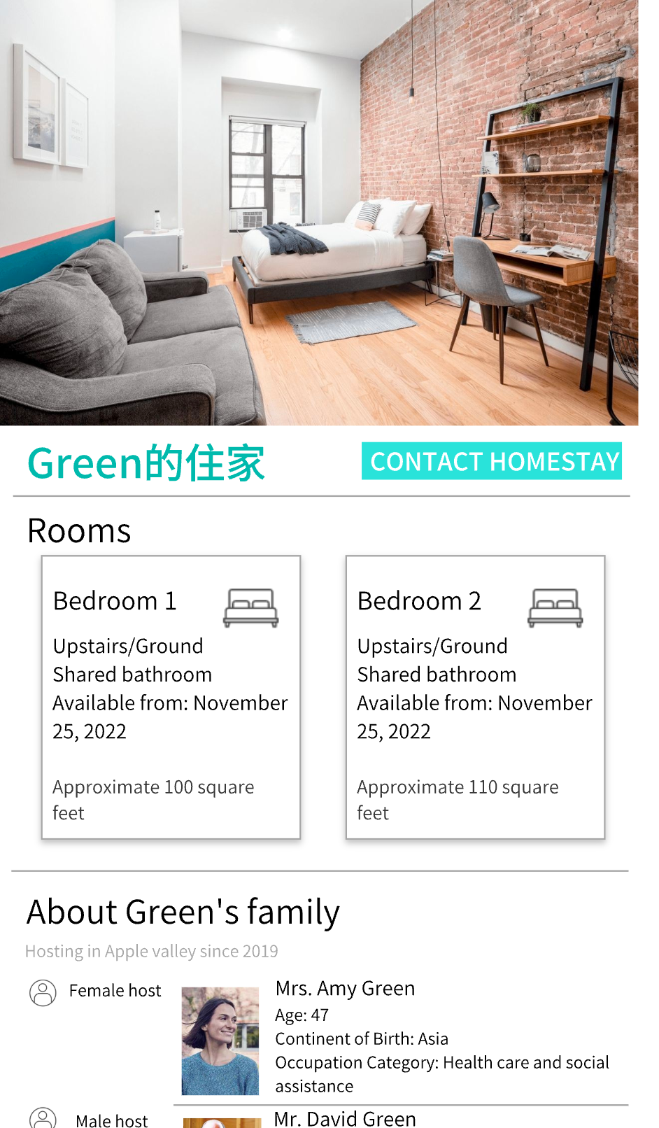
Add host to contact list
After finding a host family, we can add the contact to your contact list and communicate with them by click on the "CONTACT HOMESTAY".Then we can chat with the host and reserve rooms, which is the 3rd step.
Communication
To reserve rooms, we also provide one-to-one consulting service online for answering all kinds of questions about college entrance questions, nearby environment, security standard and so on. We also build links between host and students that they can have house viewing service.
The counseling service is provided in the chat page called “your private assistant” which may ask for additional payment.
Figure 3: There is the "CONTACT HOMESTAY" button at the top right. Also, if you scroll down this page, you can also get more information as said above about the host family.

Slide 18
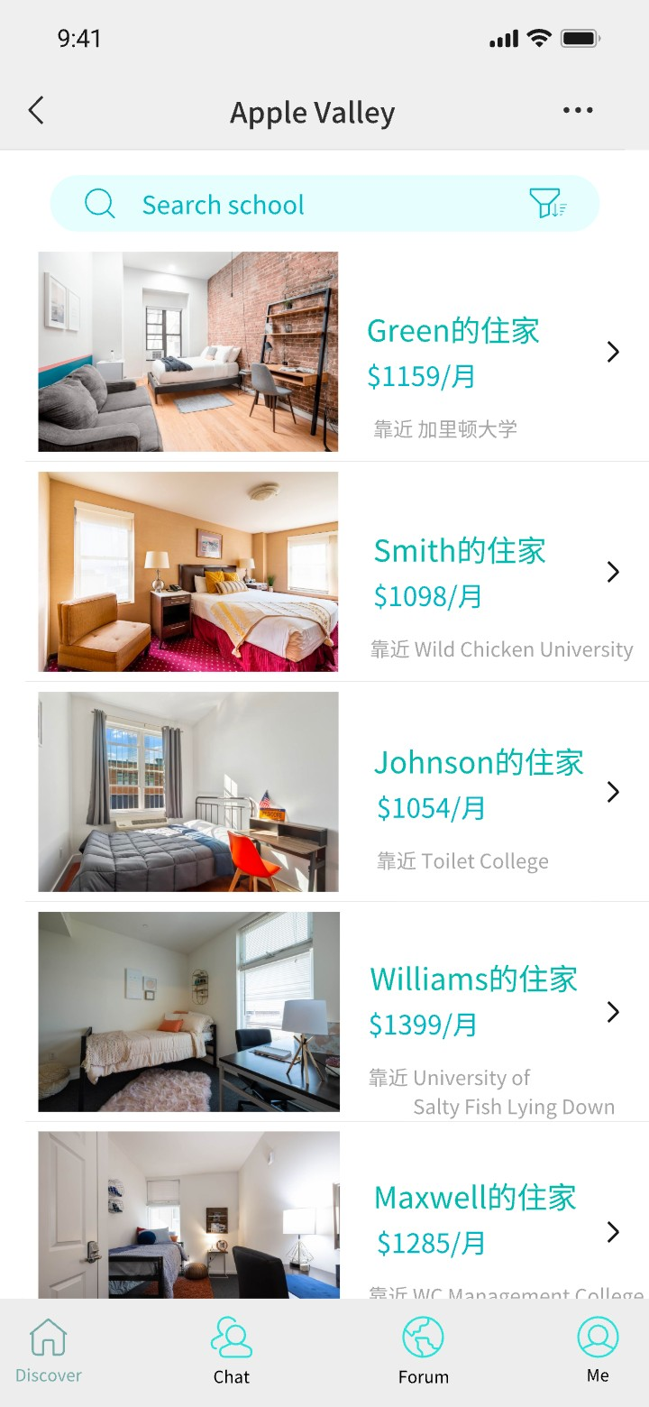
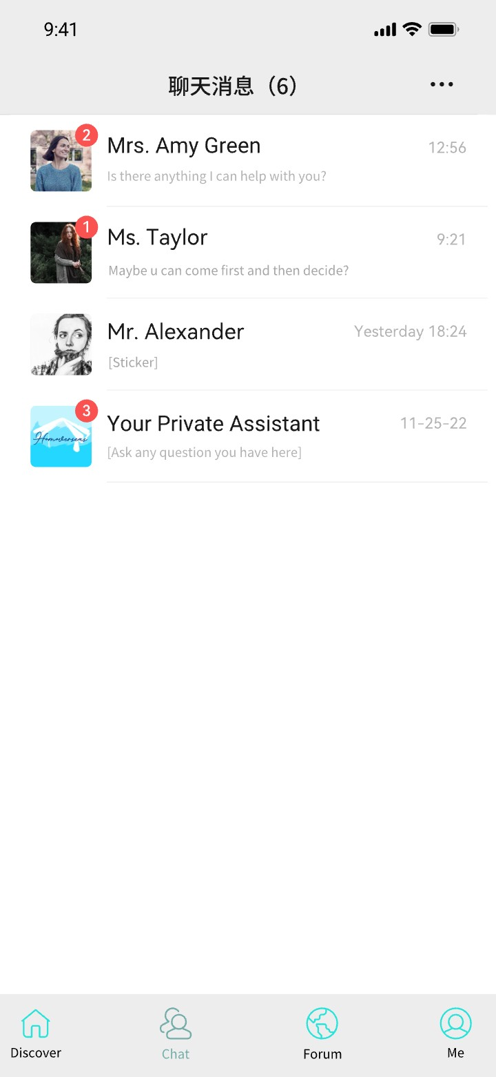
Figure 4: Discover page of our app, Figure 5: This is the chat page where where students can choose different students can chat to host family own- host families according to the price, ers and there’s also "Your Private Assis- universities and countries and regions. tant", who can help with any question
about studying abroad.
7.1.3 More functions
We have even more functions. We plan to make it not only a communication linkage between host families and students, but also a useful social media. In our forum page shown in Fig.6, we can share the experience of living in foreign countries and the useful ideas of applying to universities. They can also ask questions about nearly anything related to living abroad. The second post in Fig.6is an example of asking questions in the forum. You can briefly preview the questions and some answers with high approval rates. If you want to know more or answer it by yourself, you can click on "Enter Question" button.

Slide 19
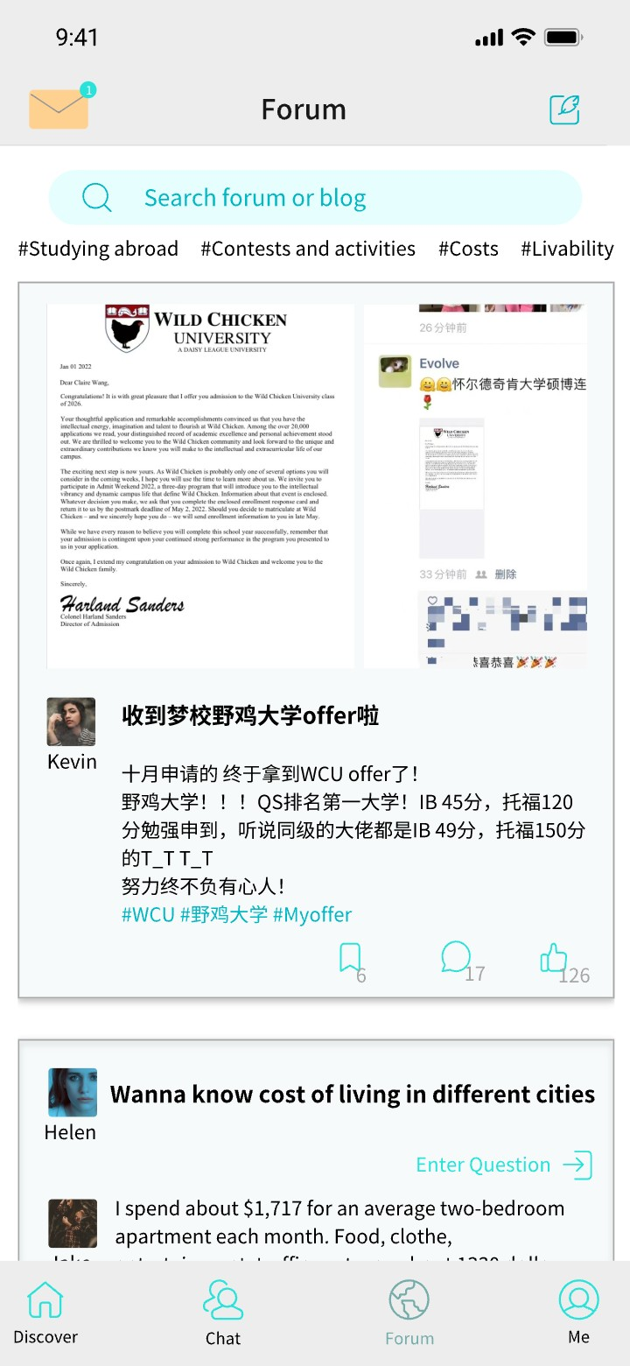
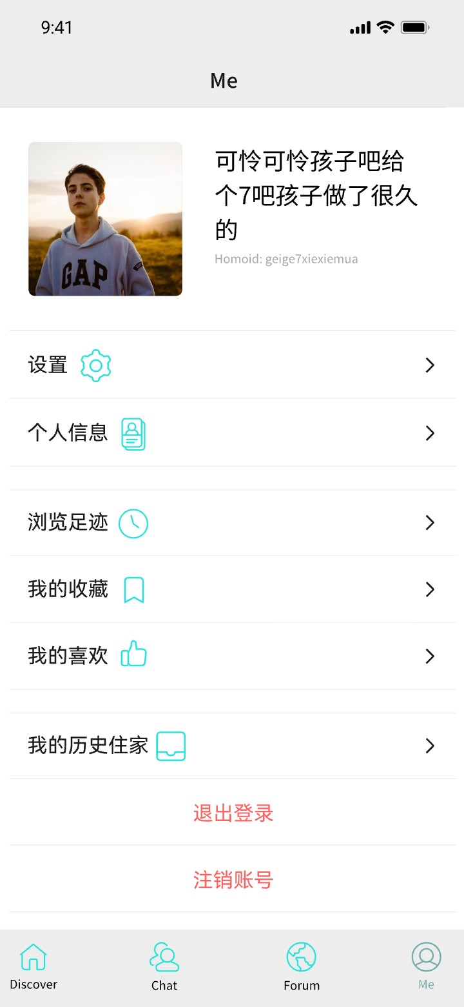
Figure 6: This is the forum page of the Figure 7: This is the "me" page where app, students can ask different ques- we can edit our profile and see our dis- tions about studying abroad and shar- cover history and history homestay in- ing their own experience and studying formation.
lives
7.2 Price
The process of our APP will undergo two stages with different pricing strategies for each. While before, we will first briefly introduce our investment which serve as a start-up capital of our company.
Before the product launch of our APP, we need to find enough investment to help us to thrive through early periods of our business. Since the techniques and prototype is feasible and complete, we will apply for the College student start-up loan and subsidy for approximately 100,000 RMB. By applying so, we can expand our company scale, make more small media propaganda like Little Red Book or TikTok, and improve our APP. After that, with more customer flow and advanced techniques, we can seek in- vestment from wealthy big companies like Tencent. Thus, our company’s first half-year development is guaranteed.

Slide 20
During the first stage, we will use strategy of penetration when we first set up this APP and put it into the market. This will help us to attract both willing hosts and the tenants since it’s at a lower price with promising of same service comparing with our competitors. We can create brand awareness during this process as well as increase our market share rapidly by several promotion strategies. To be specific, our app will be free to download, 500 RMB per month for advertisement space, and the agency fee is 15% from the dealing prices of both the hosts and the customers, so our price is comparatively low during this pricing stage¹.
We choose penetration first since we have enough investment to support our business strategies before our pricing stage. So that our first objective is to attract more cus- tomers as quickly as possible and to set up a decent image to make them familiar with our app which leads them to introduce our app to their families or friends which is be- cause of the reason that most students who studied abroad always have lots of friends or relatives studying abroad too.
After that, both cost plus and skimming is used at the second stage. The former is for functions and service’s fee increasing and the latter is for commercials and advertise- ments space. This is available since we have already set up our customer base during the penetration process with decent renown. The new functions to show our prod- uct’s uniqueness compared to our competitors like off-line house viewing service and one-to-one communicating channel are presented on the APP during this stage. Cost plus is easy and quick to calculate and ensure our APP’s daily profits; and skimming can maximize our short-run profits. This helps us to recover research and development costs quickly and create a qualified image for our customers. To be specific, our app will cost a 5 RMB download’ fee, about 3,000 RMB per month for advertisement space, and the agency fee is about 25%-35% of dealing price from both sides.
The reason for choosing Cost plus and Skimming at our second stage has following reasons. We had already gained great numbers of loyal customers with renown, so it’s time to improve the image of our product of high quality to fit with our techniques and unique functions presented in our app. This also helps us to gain and maximize our profits rapidly by memberships mechanism and to attract companies who need advertisements. As newborn apps, our advertisement fees will be much more cheaper than others, and this may be the reason why other companies may be interested in our advertisement space rather than others in order for higher returns on investment and further development.
¹Domestic agency fee is about 40% from both sides. We also ask international students, the school district takes $500 out of $1400.

Slide 21
Place
We can view our position in the market from two perspectives in two different stages.
In the first stage, we are the retailer between the host and the customer since our APP provide the hosts with a platform to advertise their housing resources and at the same time provide the tenants with suitable and diverse homestay choosing opportunities in this APP. In another word, we are the intermediary agent.
During the second stage of our promotion, we provide various specialized service like counseling and house-viewing to show our app’s uniqueness. And in this case, we are the direct service provider which is responsible for the process from producer to customer.
Promotion
We will use both the above line promotion and below promotion as our promotion strategies. For above line promotion, we can invite people around us to experience our service for free and let them to post videos on social media like TikTok, Weibo, Twitter, Little Red Book, Bilibili and so on. (If needed we can pay fee for this.) We can also ask for bloggers/vloggers overseas, pay for implant advertisement.
The reason why we choose these three ways of advertising is that the young generation now do not watch TV, listen to radio, read Newspaper and Magazine very often. So that advertisement may not be seen in those advertising strategies. Also, they cost lots of money and cannot make a precise strike to attract out customers.
In comparison to them, the three promotion strategies we will use have these advantage. First, they’re very cost effective in small streaming media with fast advertisement- spreading speed. Second, big data will help us to deliver the video to the right group. Last, because of the reason that the videos include personal experience, it is more persuasive and authentic.
There are also several below-the-line promotions. We provide discount coupons for customers who invite new users to our APP. For the first-use user, extra service would be provided lasting for one week. Since students abroad usually have the habit of checking e-mail every day, we can also use e-mail to deliver advertisements. This can also help to minimize the cost and attract more customers with loyalty.

Slide 22
8 Predicted profit and loss statement of the first two years
Projected Profit & Loss account for Homoverseas for 2023 and 2024 December 31st
Sales revenue
Advertisement space Download fee Agency fee
Total Sales revenue
Costs of Good Sold (COGS): Direct labour
Gross Profit
Less Expenses
2023($)
2024($)
6,000
N/A 31,300,000
31,306,000
192,000
31,114,000
180,000
15,000
94,100,000
94,295,000
0
94,295,000
Maintenance | 1,056,000 | 1,152,000
Agency cooperation fee | 2,100,000 | 4,200,000
Rent for the office | 2,090,400 | 2,090,400
Water, electricity fee | 18,000 | 18,000
Facilities | 68,000 | 15,000
Advertisement | 248,800 | 373,200
Management fee | 8,316,000 | 10,160,000
Rents | 690,200 | 290,400
Total Expenses
Net profit before interest and tax
Less Interest
Net profit before tax
Less Tax
Net profit after interest and tax
Dividends
Retained Profits
14,587,400
16,526,600
18,299,000
75,996,000
30,024
16,496,576
12,633
75,983,367
4,124,144
12,362,432
18,995,842
56,987,525
8,000,000
4,362,432
25,000,000
31,987,525
Table 1

Slide 23
1. Sales revenue
For the first year 2023, we first set our company up and we will have lower price for advertisement space, download fee and agency fee. As we explained in Section 7.2, we will have a free download service, 500 RMB/month for advertising and the agency fee will be 15% from both sides.
We expect that in 2023 there will be 2,000 downloads, in average there will be 1,000 host families registered in our application receive international students in their family and average charge of host families is $1250.
Agency fee (from each students/ host family) = 1250 × 15%= 187.5 per month,
The total agency fee in 2023 = 1, 000 host families ×12 months×187.5×2 = 4, 500, 000 dollars ≈ 31,300,000 RMB.
There are 5 places for advertising, so the total income of advertisement space in 2023= 5 × 500 × 12 months=6,000 RMB.
For 2024, we expected 2,000 host families registered in our application and the agency fee from host family will be 25% to 35% according to different charge of host family while the agency fee from students will still be 15%. (For example, we are planning
to set ª = p in which a is the agency fee while c is the charge of host family and
c
c
p = ₁₂₅₀ × 30% when p is between 25% to 35%, when c is smaller than 1040, p will
remained to be 25% and when c is larger than 1460, p will remained to be 35%).
We still consider 1250 to be the average charge of host family.
Agency fee (from each students) = 1250 × 15%= 187.5 per month, Agency fee (from each host family) = 1250 × 30%= 375 per month,
The total agency fee in 2024 = 2, 000 host families ×12 months×(187.5 + 375) = 13, 500, 000 dollars ≈ 94,100,000 RMB.
In 2024, since our application will become more famous, we can ask for higher adver- tising fee which will be 3,000 RMB.
Income of advertisement space in 2024 = 5 × 3, 000 × 12 months=180,000 RMB.

Slide 24
We also ask for 5 RMB for download fee in 2024. We expect 3,000 new downloads in 2024 (1,300 of students and 1,700 of host families join in our application in 2024).
The total income of download fee in 2024 = 3, 000 × 5 = 15, 000 RMB
Cost of good sold (COGS)
Our product cost of good sold in 2023 will include the cost of building and maintaining our app. We will hire 4 IT programmers (4 subordinates of post-maintenance manager) to build our application. To be specific, 2 front end engineers and 2 back end developer. We will hire them for 1 month to build the base of the application for us and the cost of building up the application will be 192,000 RMB ².
Direct labour cost in 2023 = 192, 000 RMB.
Because the build up has been done in 2023, in 2024 we will not have direct labour cost.
Gross Profit
The gross profit would be the difference between sales revenue and costs of goods sold (COGS).
Gross Profit 2023 = 31,306,000 - 192,000 = 31,114,000
Gross Profit 2024 = 94,295,000 - 0 = 94,295,000
Maintenance fee
For the next 11 months after the build up of our application in 2023, we will hire only two of them to maintain the program of our app.
Maintenance 2023= 11 months ×2 × 48, 000 = 1, 056, 000 RMB.
In 2024, we will only apply 2 programmer to maintain the program, and they will stay for the whole year.
Maintenance 2024 = 12 months ×2 × 48, 000 = 1, 152, 000 RMB.
Fees for cooperation with the agency in charge of house viewing
²https://www.glassdoor.com/Salary/Tencent-Salaries-E38281.htm

Slide 25
Because we need to provide offline house viewing service, we need to cooperate with agency in charge of house viewing. The agency can get about 3% of the total fee ³ when they successfully facilitate a deal. We expect to calculate the agency fee according to how many months the students stay in the host family, which means the fees for coop- eration with the agency in charge of house viewing will be equal to 2% × 12 months× charge of host family.
Agency cooperation fee 2023 = 2%× 1250 ×12 months × 1,000=300,000 dollars ≈ 2,100,000 RMB.
Agency cooperation fee 2024 = 2%× 1250 ×12 months × 2,000=600,000 dollars ≈ 4,200,000 RMB.
Rent for the office
We predict that we are going to have 44 people in total in our office, so we plan to rent a 544.49 m² office in Shanghai Jinmao Tower (No.88, Century Avenue, Pudong New Area, Shanghai) ⁴. The rent charge for this office is 174,200 RMB/month.
Rent fee 2023 2024=174,200×12 months=2,090,400 RMB.
Water and electricity fee
The water and electricity fee cost is for our office. We predicted that the cost will be 18,000 RMB annually.
Facilities
Our company contains 40 workers excluding Muriel, Eddie, Suky and Stephanie. We plan to buy 40 computers for our company. Since the office we rent contains basic office furniture, we will only prepare computers (about 1,700 RMB will be enough) for workers.
Facilities fee 2023=40×1, 700=68,000 RMB.
In 2024, we expect to spend 15,000 RMB on office facilities to add facilities our em- ployees require.
Advertisement
We plan to place advertisements on video platforms. for example we will work with student uploaders on Bilibili who are studying abroad and pay them to place ads for our
³https://new.qq.com/rain/a/20200506A0OTUJ00 ⁴https://sh.diandianzu.com/listing/housedetail-i85077li32.html

Slide 26
products in their videos. Usually they also have YouTube accounts to upload videos, so we can kill two birds with one stone and ask for discount since they only need to make one video. The price quoted for a custom video for an ad is about 10,000 RMB ⁵for most student uploaders with about 10w+ followers⁶. We are ready to invest promotion costs on 8 video makers in this category in 2023 year.
International students on YouTube platform also like to watch videos from domestic and Taiwanese video makers. We are going to choose 2 video producers to advertise on YouTube platform. For example, we choose Leonard and Realpotterking to help us with promotion. The advertising fee of Leonard is 137,800 RMB/ video⁷ and the advertising fee of Realpotterking is 31,000 RMB/ video⁸.
Advertisement 2023 = 10,000×8+31,000+137,800=248,800 RMB.
For 2024, we will ask 15 videos producer in total. The proportion of our advertising spend on Bilibili and YouTube platforms in 2024 remains the same as in 2023.
Advertisement 2024 =
10. Management fee
248, 800
10
× 15=373,200 RMB.
The base salary of Homoverseas’ employees is differentiated by position. We expect a base salary of 40,000 RMB per month for 4 directors, 20,000 RMB per month for 10 managers, and 8,000 RMB per month for each employee except for 4 IT staff. For the 4 IT employees, because they already have a high salary of 48,000 RMB per month, we will not give them dividends and bonus.
We also prepare 1,500,000 RMB in total to use as bonus for employees to encourage them and stimulate their passion for work.
Management 2023 = 40,000×12 × 4 + 20, 000 × 12 × 10 + 8, 000 × 12 × 26 = 8, 316, 000 RMB.
In 2024, because we earn more, we consider to raise the base salary and bonus. We consider the base salary for directors to be 50,000 RMB per month; the base salary for managers will be 22,000 RMB per month and the base salary for 26 base employees will be 10,000 RMB per month. The total amount of bonus will be increased to 2,000,000 RMB.
⁵https://bz.feigua.cn ⁶https://www.zhihu.com/question/267785442
⁷https://cn.noxinfluencer.com/youtube/channel/UC1mx_wcSHtfpLk5N_zY0TRg ⁸https://cn.noxinfluencer.com/youtube/channel/UCsBP1dmKYfcorJ17kfOUTvg

Slide 27
Management 2024=50,000×12 × 4 + 22, 000 × 12 × 10 + 10, 000 × 12 × 26 + 2, 000, 000 = 10, 160, 000 RMB.

Slide 28
Introduction & Business idea Business objectives
Type of organization Organization chart
Market segmentation & target market Questionaire
Marketing mix Product Price
Place Promotion
Predicted profit and loss Structure
Table 2: Division of labour
Stephanie Suky Eddie Eddie Muriel Stephanie
Stephanie Suky Suky Suky Stephanie Stephanie
Tel: 777 7777 7777
www.homoverseas.com Shanghai Jinmao Tower, No.88, Century Avenue, Pudong New Area
Shanghai, China
Table 3

